Slide 1
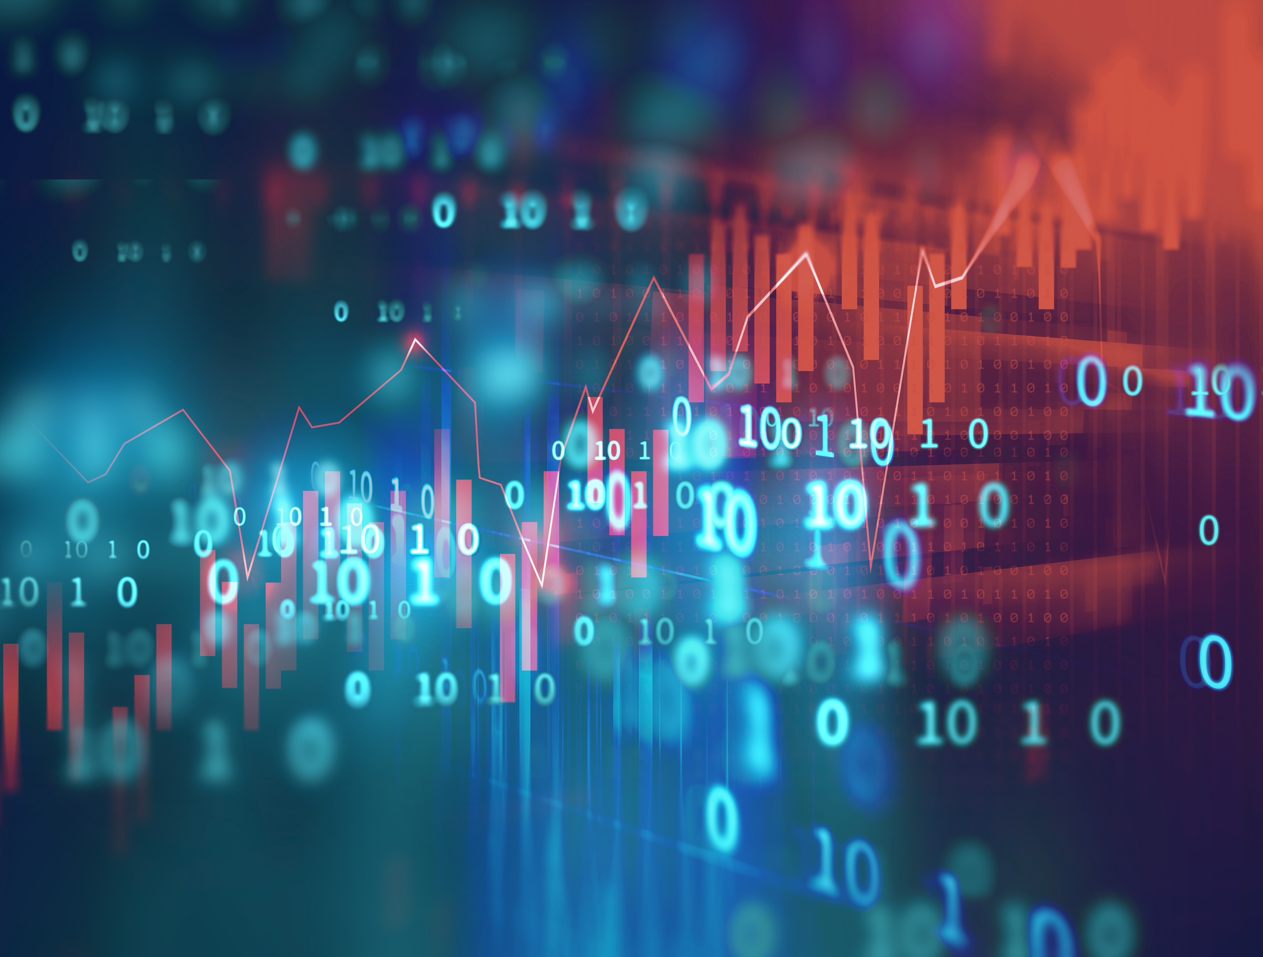
Python For Data Analysis Report
VaREZ arthur
DIA5
https://github.com/ArthurVarez/FinalProject_Python/

Slide 2
InTroduction
For this project I had to work on a dataset quantifying the drug consumptions for 1885 people.
For each respondent 12 attributes are given : 7 about personnalitie mesurements and feelings. Partcipent were asked about their habits on 18 drugs. Some are legals, some are not. There’s also a fake drug in this panel.
For those drugs they had to define their consumption : "Never Used", "Used over a Decade Ago", "Used in Last Decade", "Used in Last Year", "Used in Last Month", "Used in Last Week", and "Used in Last Day".
All the datas are categoricals but some could be interpreted as real numbers.

Slide 3
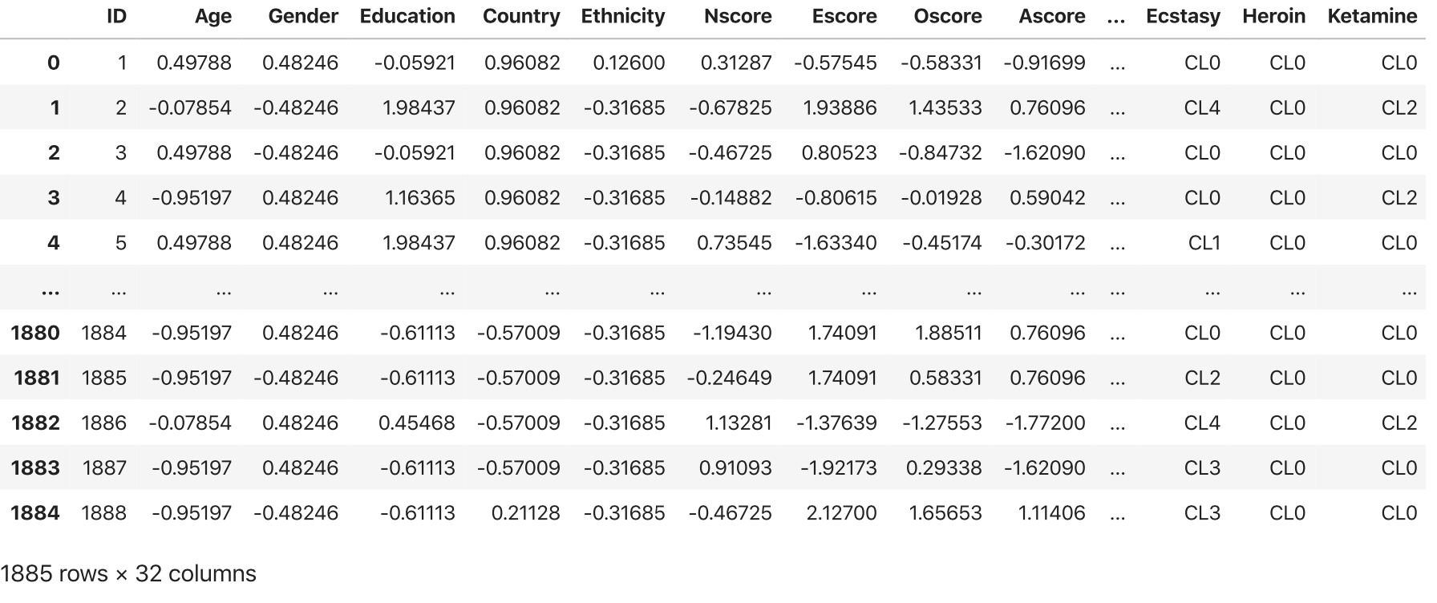
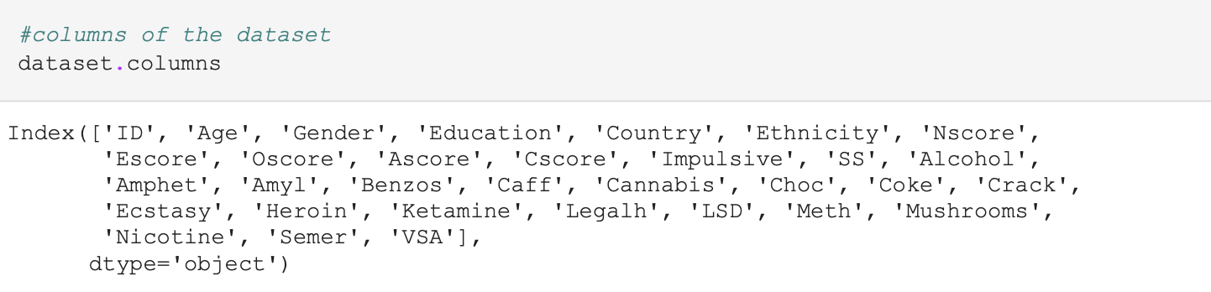
The Dataset
By using read_csv method from Pandas package, I’ve been able to load the dataset and to have a quick look on it.
Here we also have its shape and a view on the columns.

Slide 4
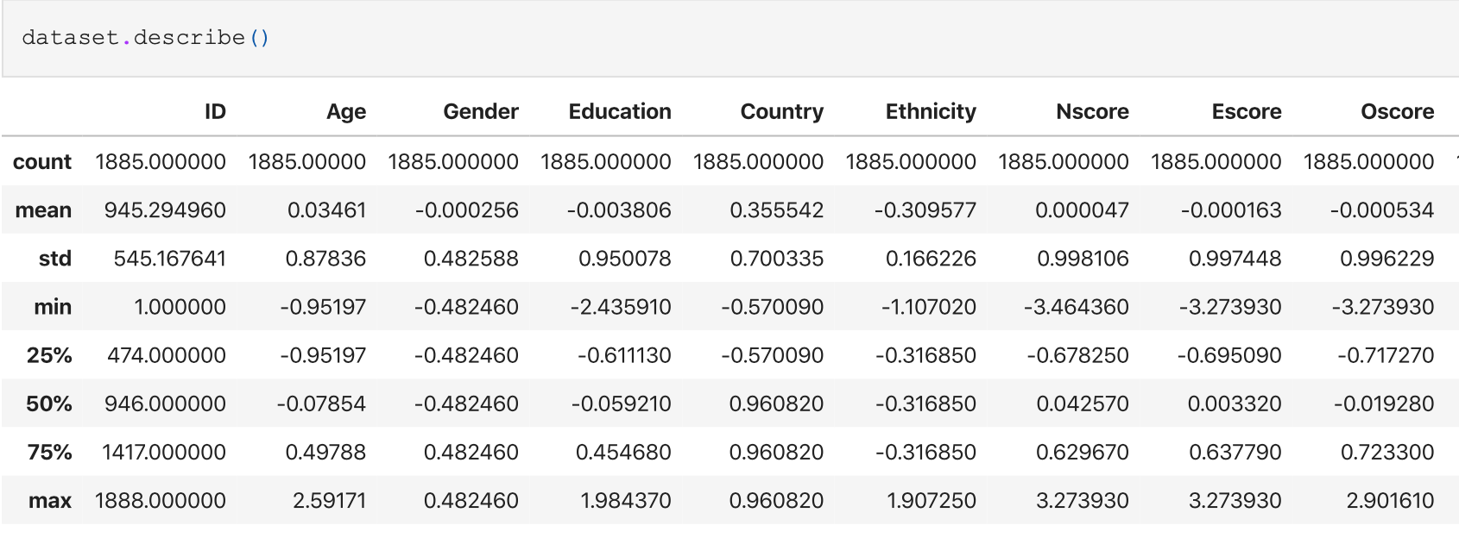
The Dataset
To have a better overview on the statistics we can use the method describe :

Slide 5
Let’s discuss about the variables
The 12 first variables are the inputs. A respondent is defined by its age, gender, education level, his current residence country and its ethnicity.
We also have personnality scores : Nscore (Neuroticism), Escore(Extraversion), Oscore(Openness to experience), Ascore (Agreeableness), Cscore(Conscientiousness), Impulsive(measuring impulsiveness) and SS (sensation seeing).
All the inputs are categorical but can be considered as real valued after quantification.
Here are the meanings for the drugs :
-CLO : Never Used
-CL1 : Used over a Decade Ago
-CL2 : Used in Last Decade
-CL3 : Used in Last Year
-CL4 : Used in Last Month
-CL5 : Used in Last Week
-CL6 : Used in Last Day

Slide 6
Let’s discuss about the variables : meaning
Age : Age categrory of the of paticipants:
- -0.95197 18-24 yo
- -0.07854 25-34 yo
-0.49788 35-44 yo
-1.09449 45-54 yo
-1.82213 55-64 yo
-2.59171 65+ yo
Eduaction : Level of education :
-2.43591 Left school before 16
-1.73790 Left school at 16 years
-1.43719 Left school at 17 years
-1.22751 Left school at 18 years
-0.61113 Some college or university, no certificate or degree
-0.05921 Professional certificate/ diploma
-0.45468 University degree
-1.16365 Masters degree
-1.98437 Doctorate degree
Gender:
- 0.48246 Female
- 0.48246 -> Male

Slide 7
Let’s discuss about the variables : meaning
- Ethnicity : ethnicity of participants:
-0.50212 Asian
-1.10702 Black
-1.90725 Mixed-Black/Asian
-0.12600 Mixed-White/Asian
-0.22166 Mixed-White/Black
-0.11440 Other
-0.31685 White
Country: current residence country :
-0.09765 Australia
-0.24923 Canada
-0.46841 New Zealand
-0.28519 Other
-0.21128 Republic of Ireland
-0.96082 UK
-0.57009 USA

Slide 8
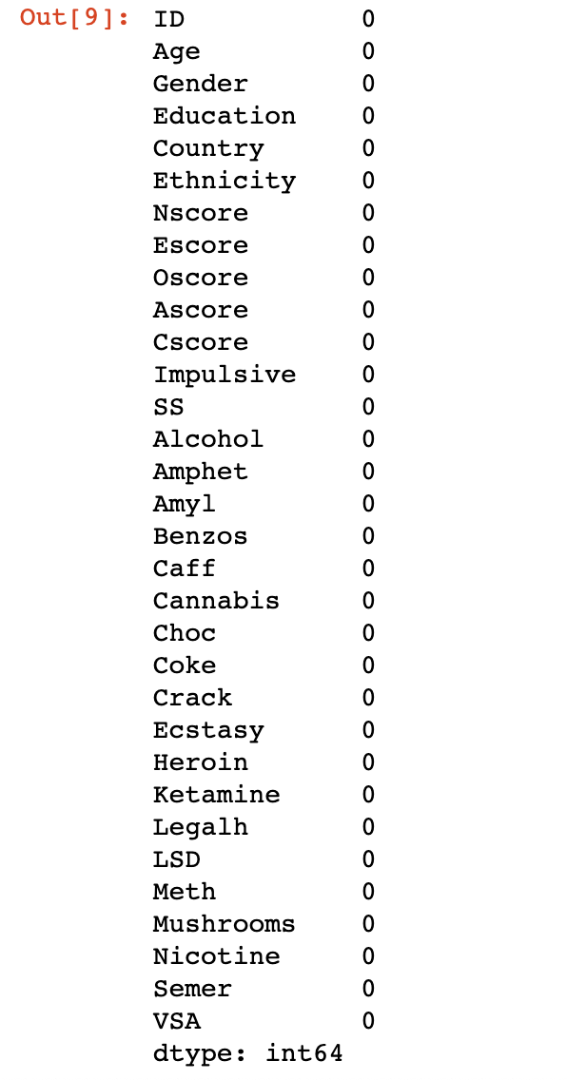
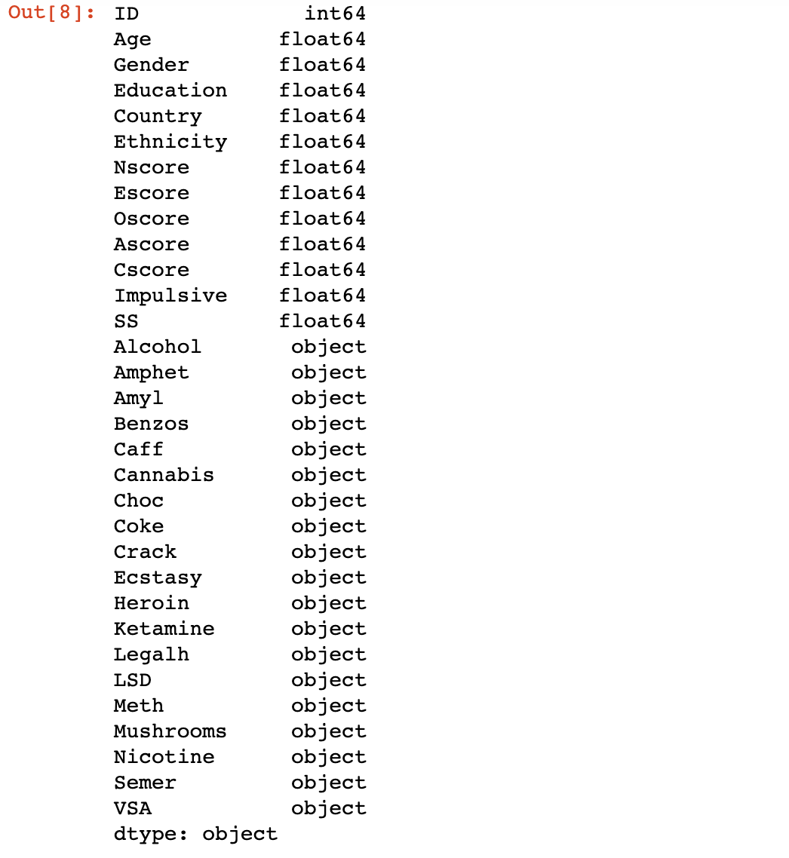
The variables
Then we wanted to check variables types and if there’s any missing values.
Object type columns are categorized drugs.
We can also see that we have no missing values, so we don’t need to replace some missing ones.

Slide 9
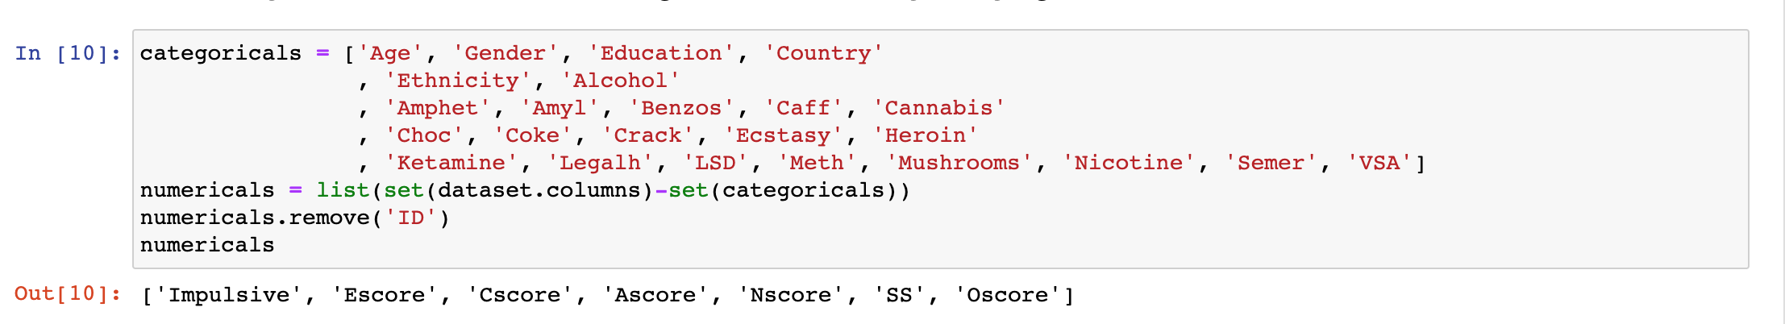
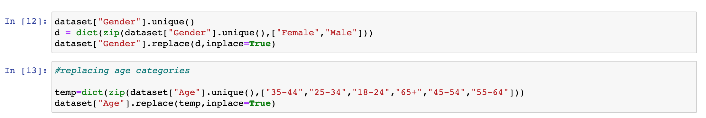
The variables
Now if decided to transform some columns into categories to have a better visualization after. So I’ve definded which ones are categoricals or not :
By following this way, we can transform all the categoricals variables :

Slide 10
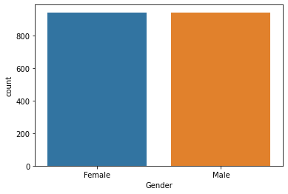
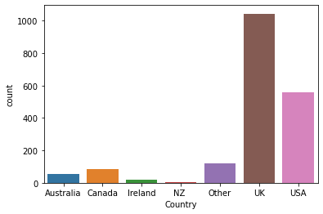
Visualization : INputs
Gender distribution
Current residence country distribution
We can see that we have almost the same number of Male and Female.
In this dataset, Americans and English are the most represented.

Slide 11
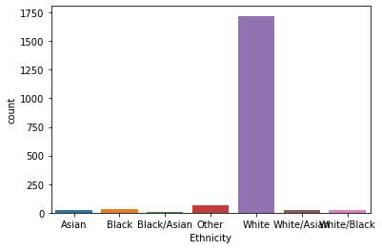
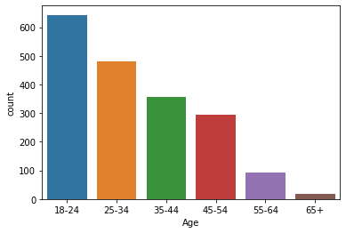
Visualization : INputs
Ethnicity distribution
Age distribution
There’s a huge proportion of white people here.
The older the people are , the less they are represented.

Slide 12
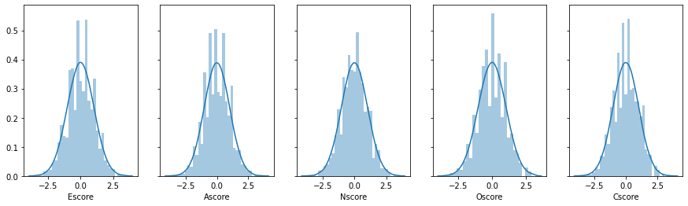
Visualization : INputs
Personnality score ditributions
Score distributions tend to be Gaussian distributions.

Slide 13
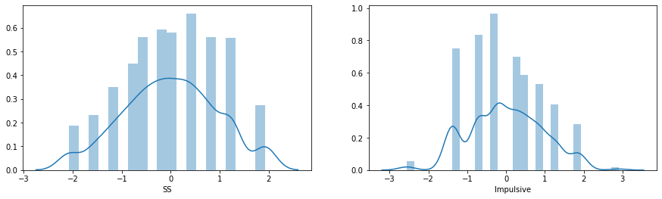
Visualization : INputs
sensation seeing and impulsiveness distributions
Here distribution are less like Gaussian distributions, may be it’s because the values are less continous.

Slide 14
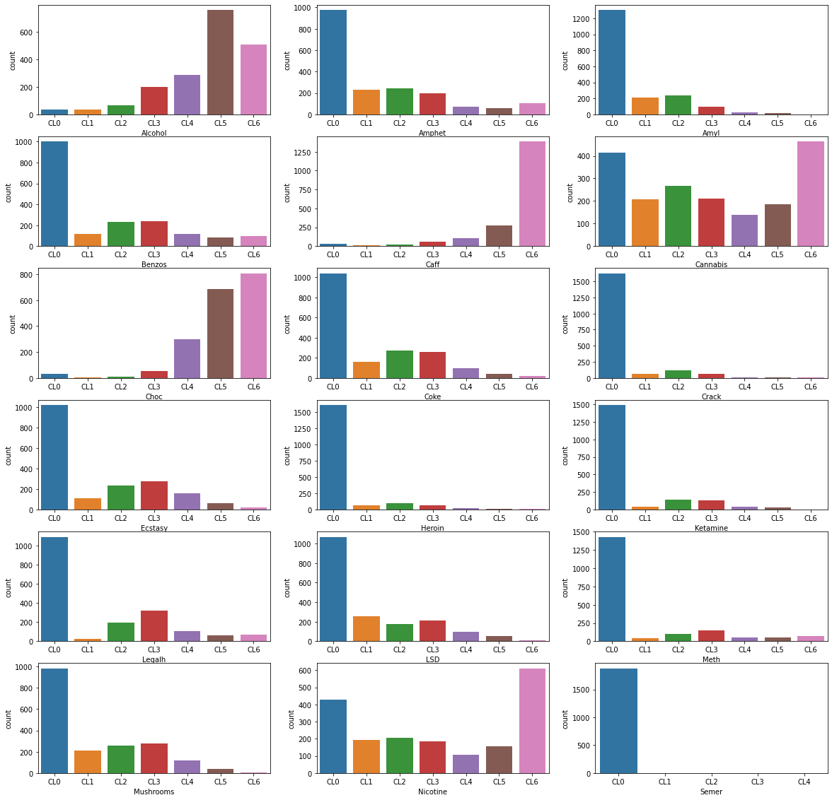
Visualization : Drugs
Visualisation of the repartion of users classes for each drug.
Legal or ”almost legal” (Cannabis) drugs seems to have been a lot experienced.

Slide 15
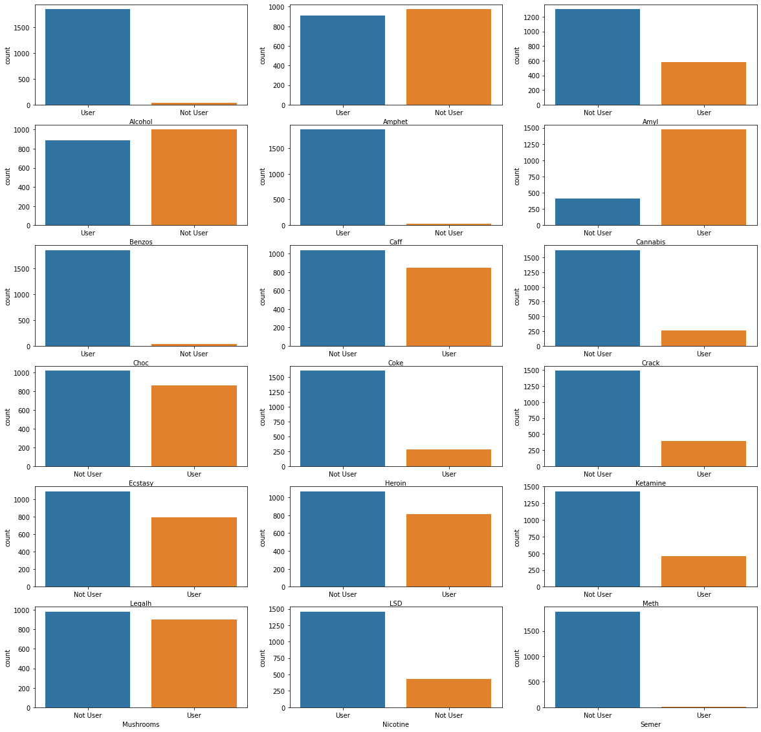
Visualization : Drugs
Proportion of users and not users for each drug:
We can draw the same conclusion as we did just before, here the proportions are more relevant.
Some drugs like ectasy, mushrooms, LSD, coke have also been a lot experienced at least one time.

Slide 16
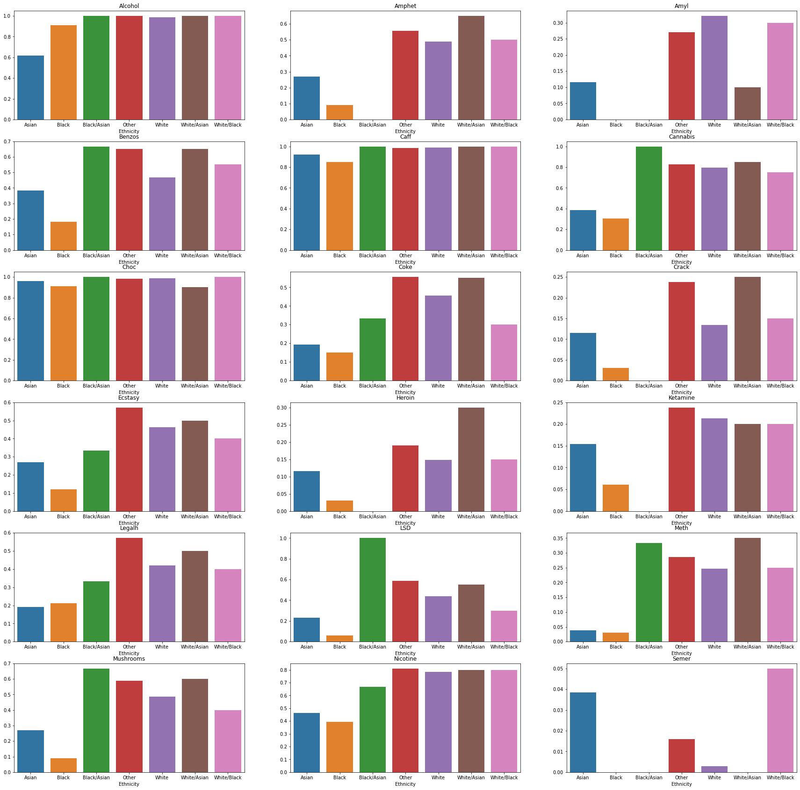
Here we can see the influence of the ethnicity on drug uses.
To visualize the proportions between ethnicities, because a huge part of our individuals are white, we need to have the ratio between the users of an ethnicity and the non users

Slide 17
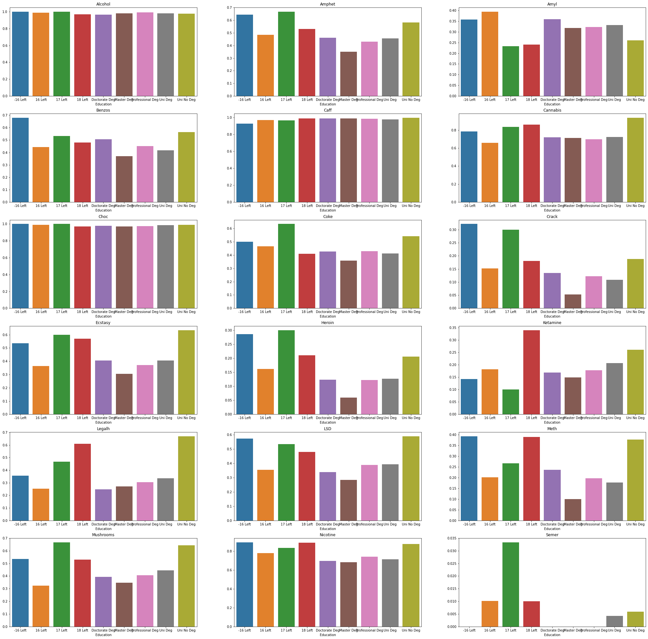
Finaly I wanted to see the influence of the education background on experiencing
drugs
Here we can see that for most of the drugs , study background is not really determinant about experiencing drugs

Slide 18
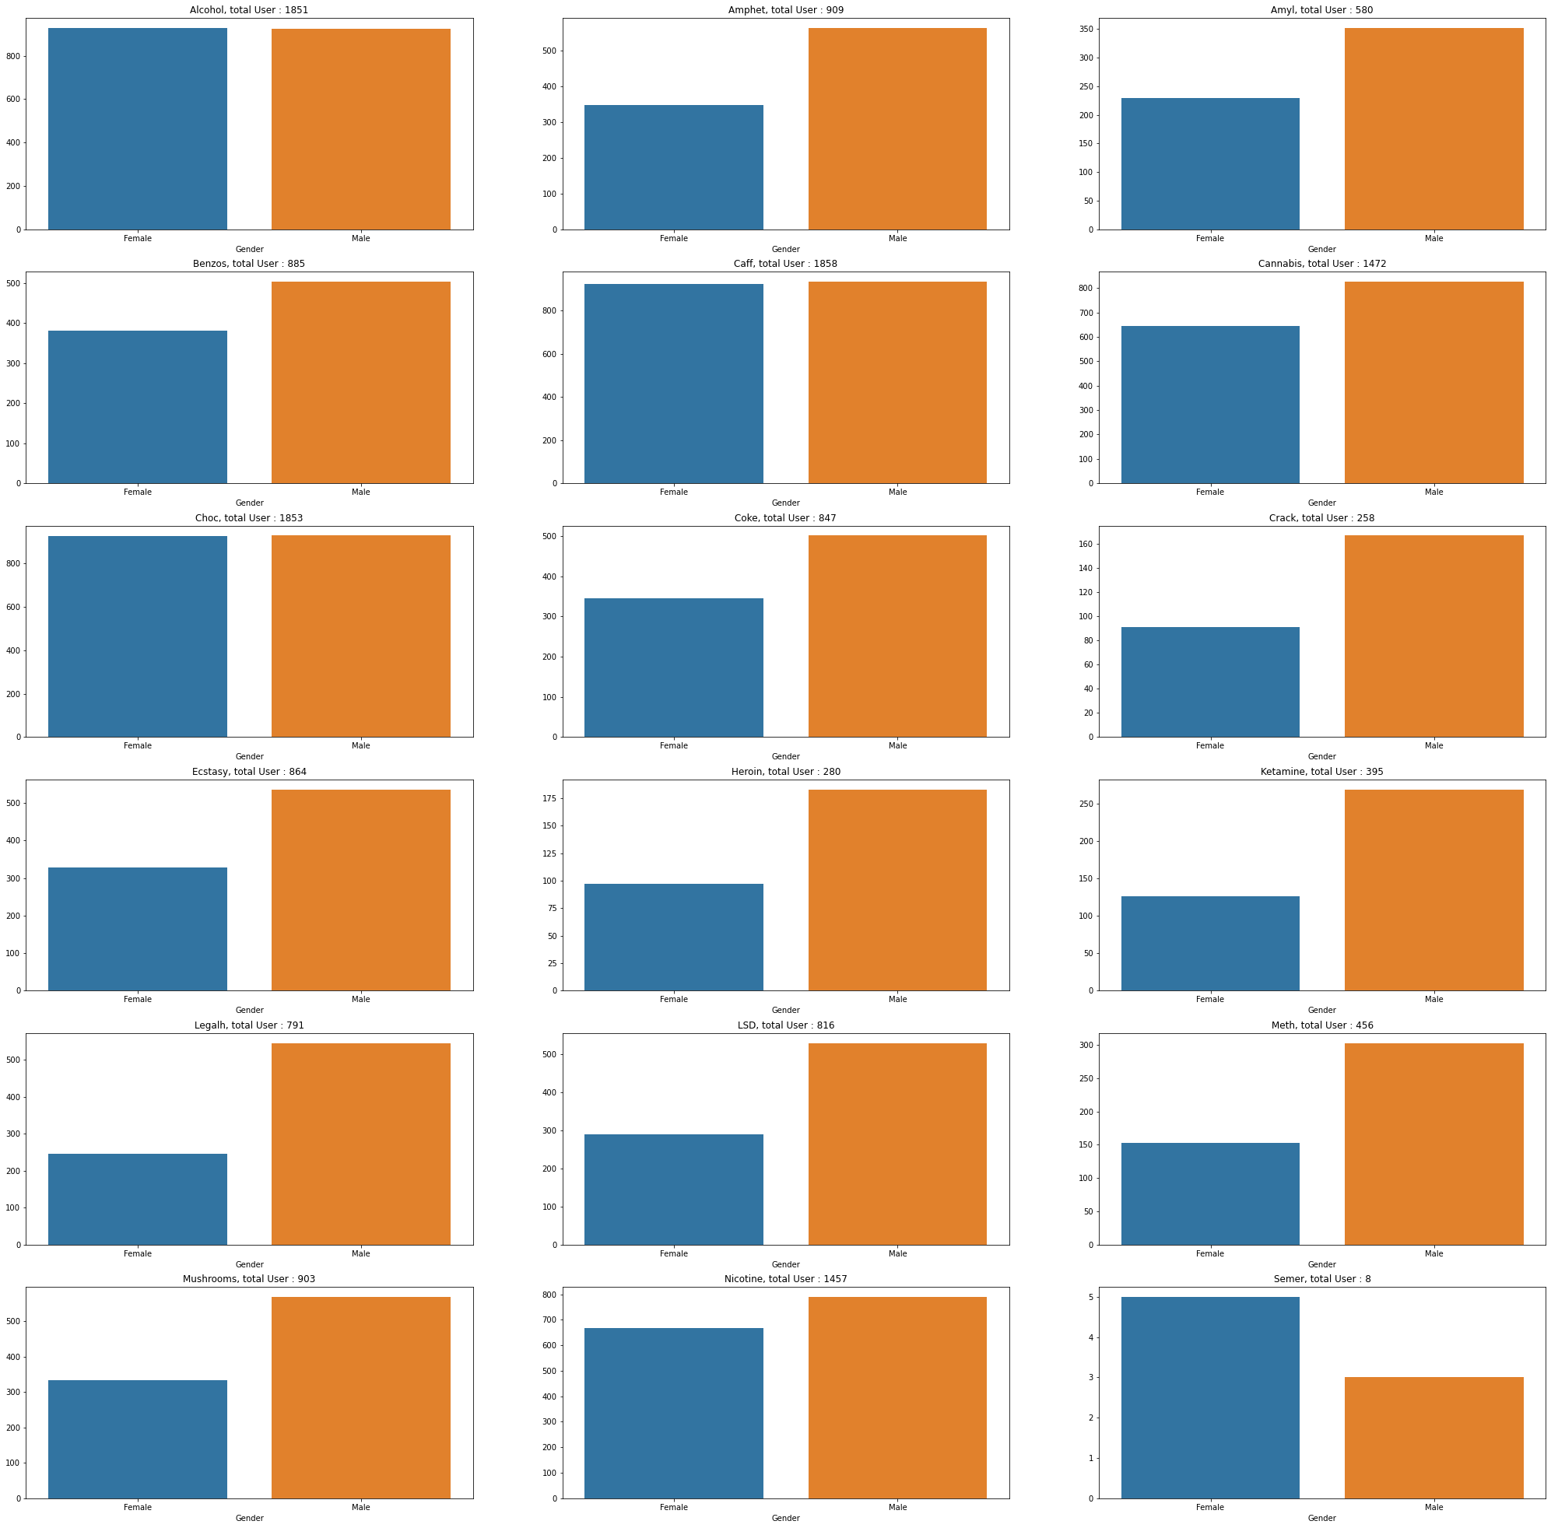
To end with visualization, we can try to see the influence of gender about taking a drug at least one time .
It seems like mens are more likely to try drugs rather the womens.

Slide 19
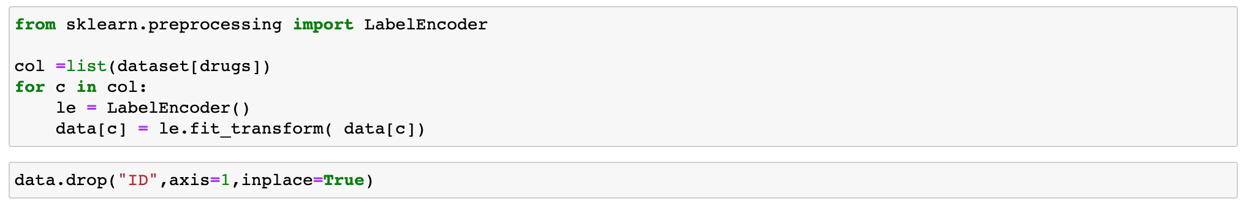
Preprocessing
To deploy Machine Learning on my dataset, I decided to do some transformation on it.
Firstly, I transformed the drugs categorical variables, by using an Encoder from Scikit Learn, to have real values.
Secondly, I’ve dropped the ”ID” feature considering it was useless.

Slide 20
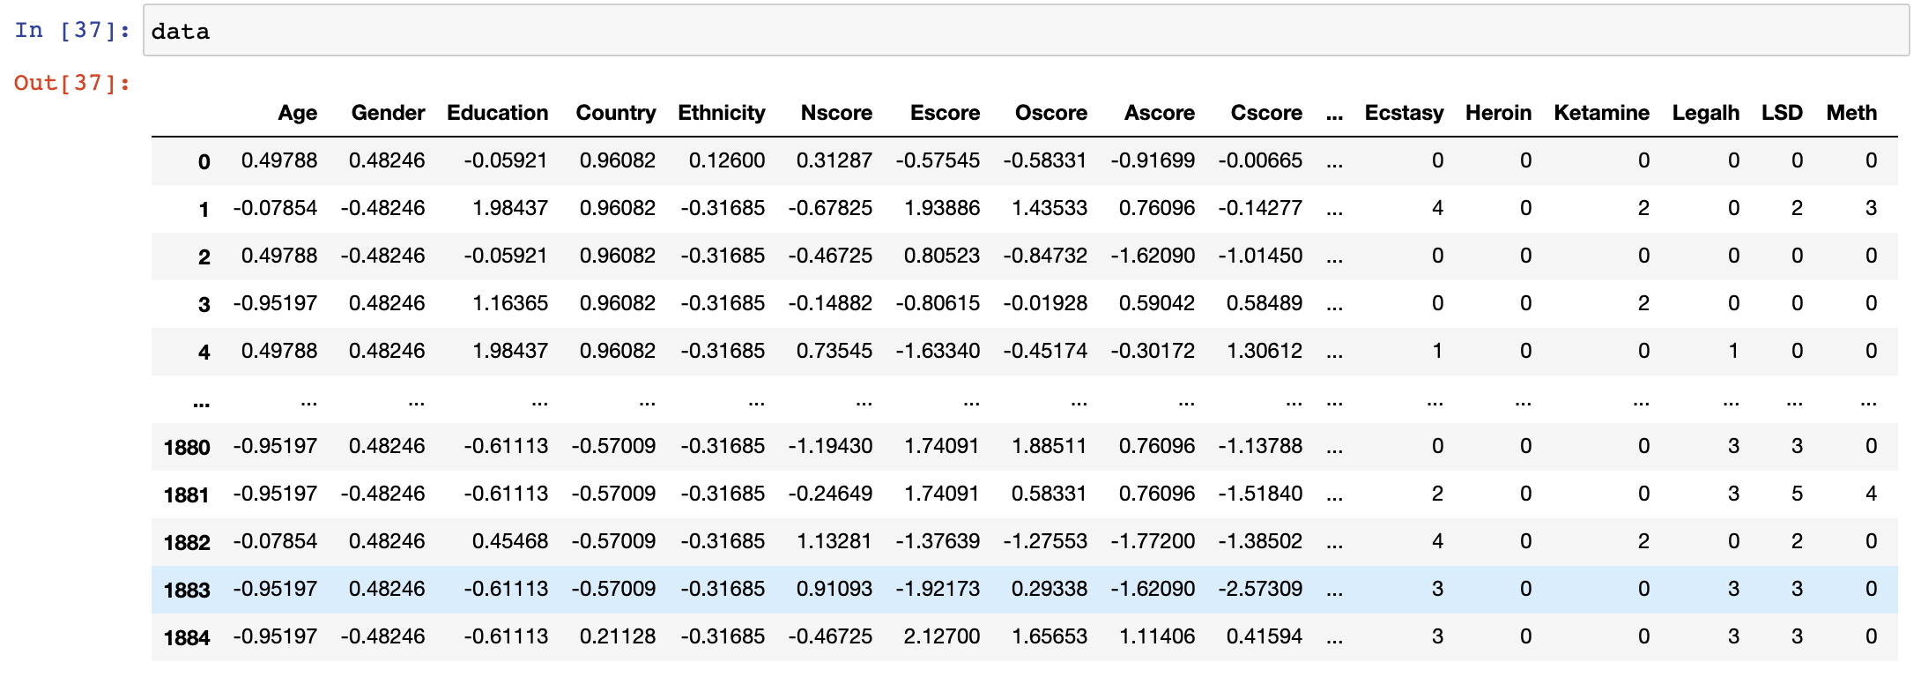
Preprocessing
So here is my dataset after the previous transformations :

Slide 21
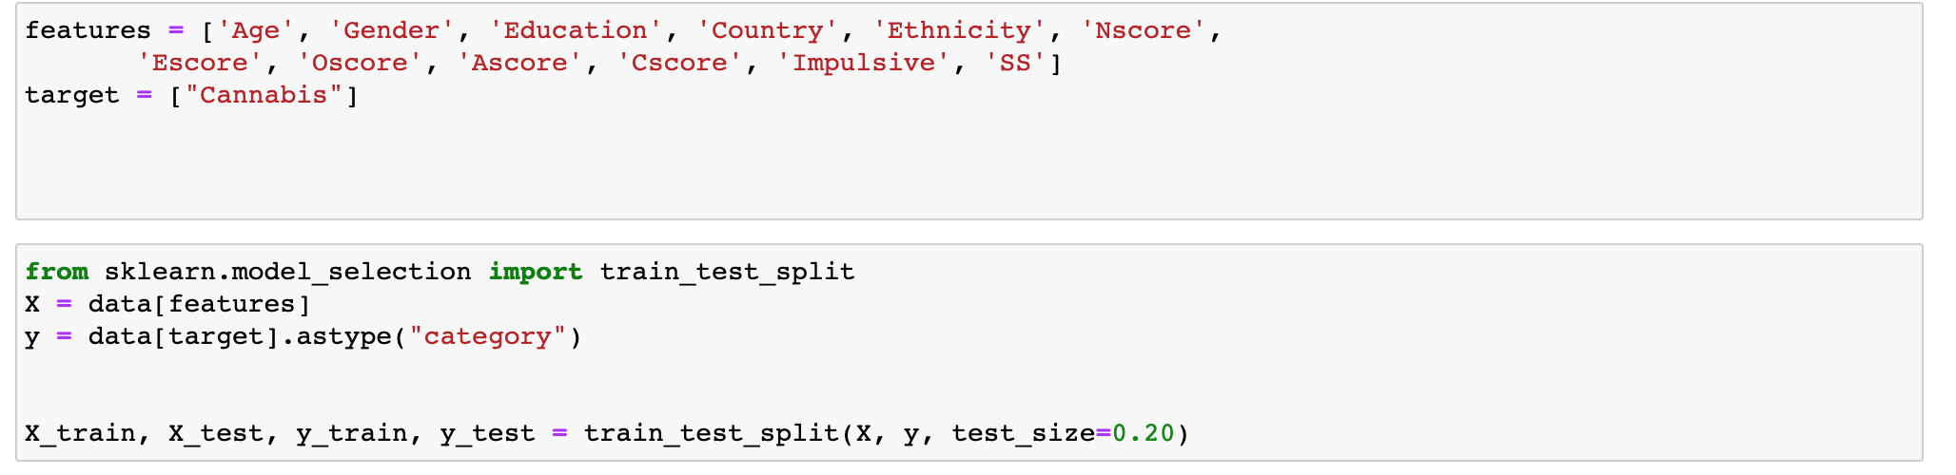
Preprocessing
By displaying the correlation matrix between our variables ( Please check it on the notebook) , I’ve decided to predict Cannabis consumption with the following features :
I’ve also split my dataset into a test set and a training set with Scikit Learn.

Slide 22
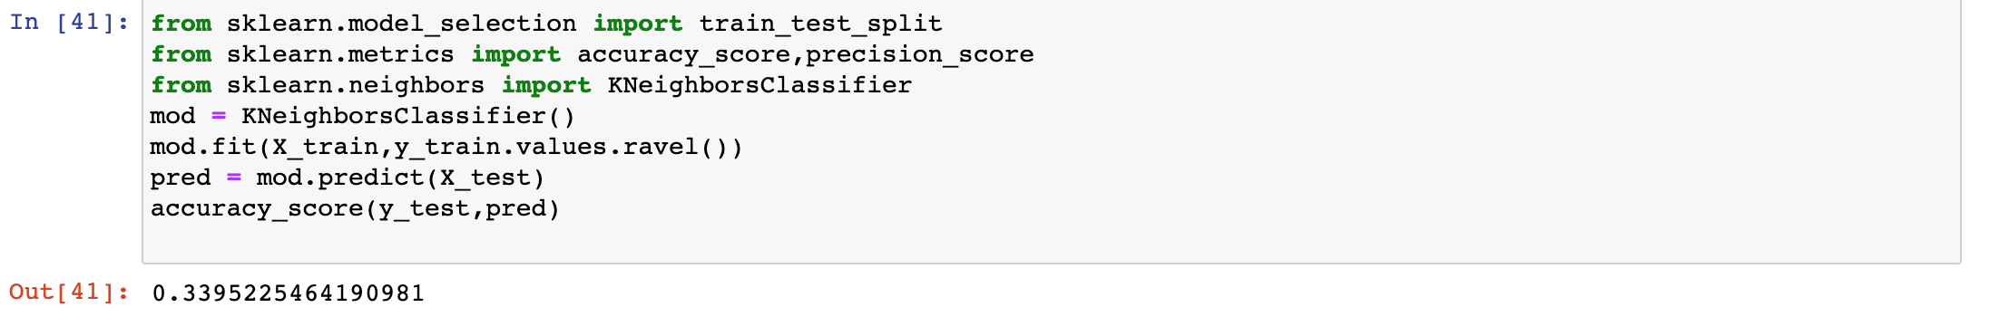
Machine Learning : KNN
Firstly I’ve tried to predict the 6 classes for the target Cannabis , to see what it can lead to.
As you can see the prediction is really bad.

Slide 23
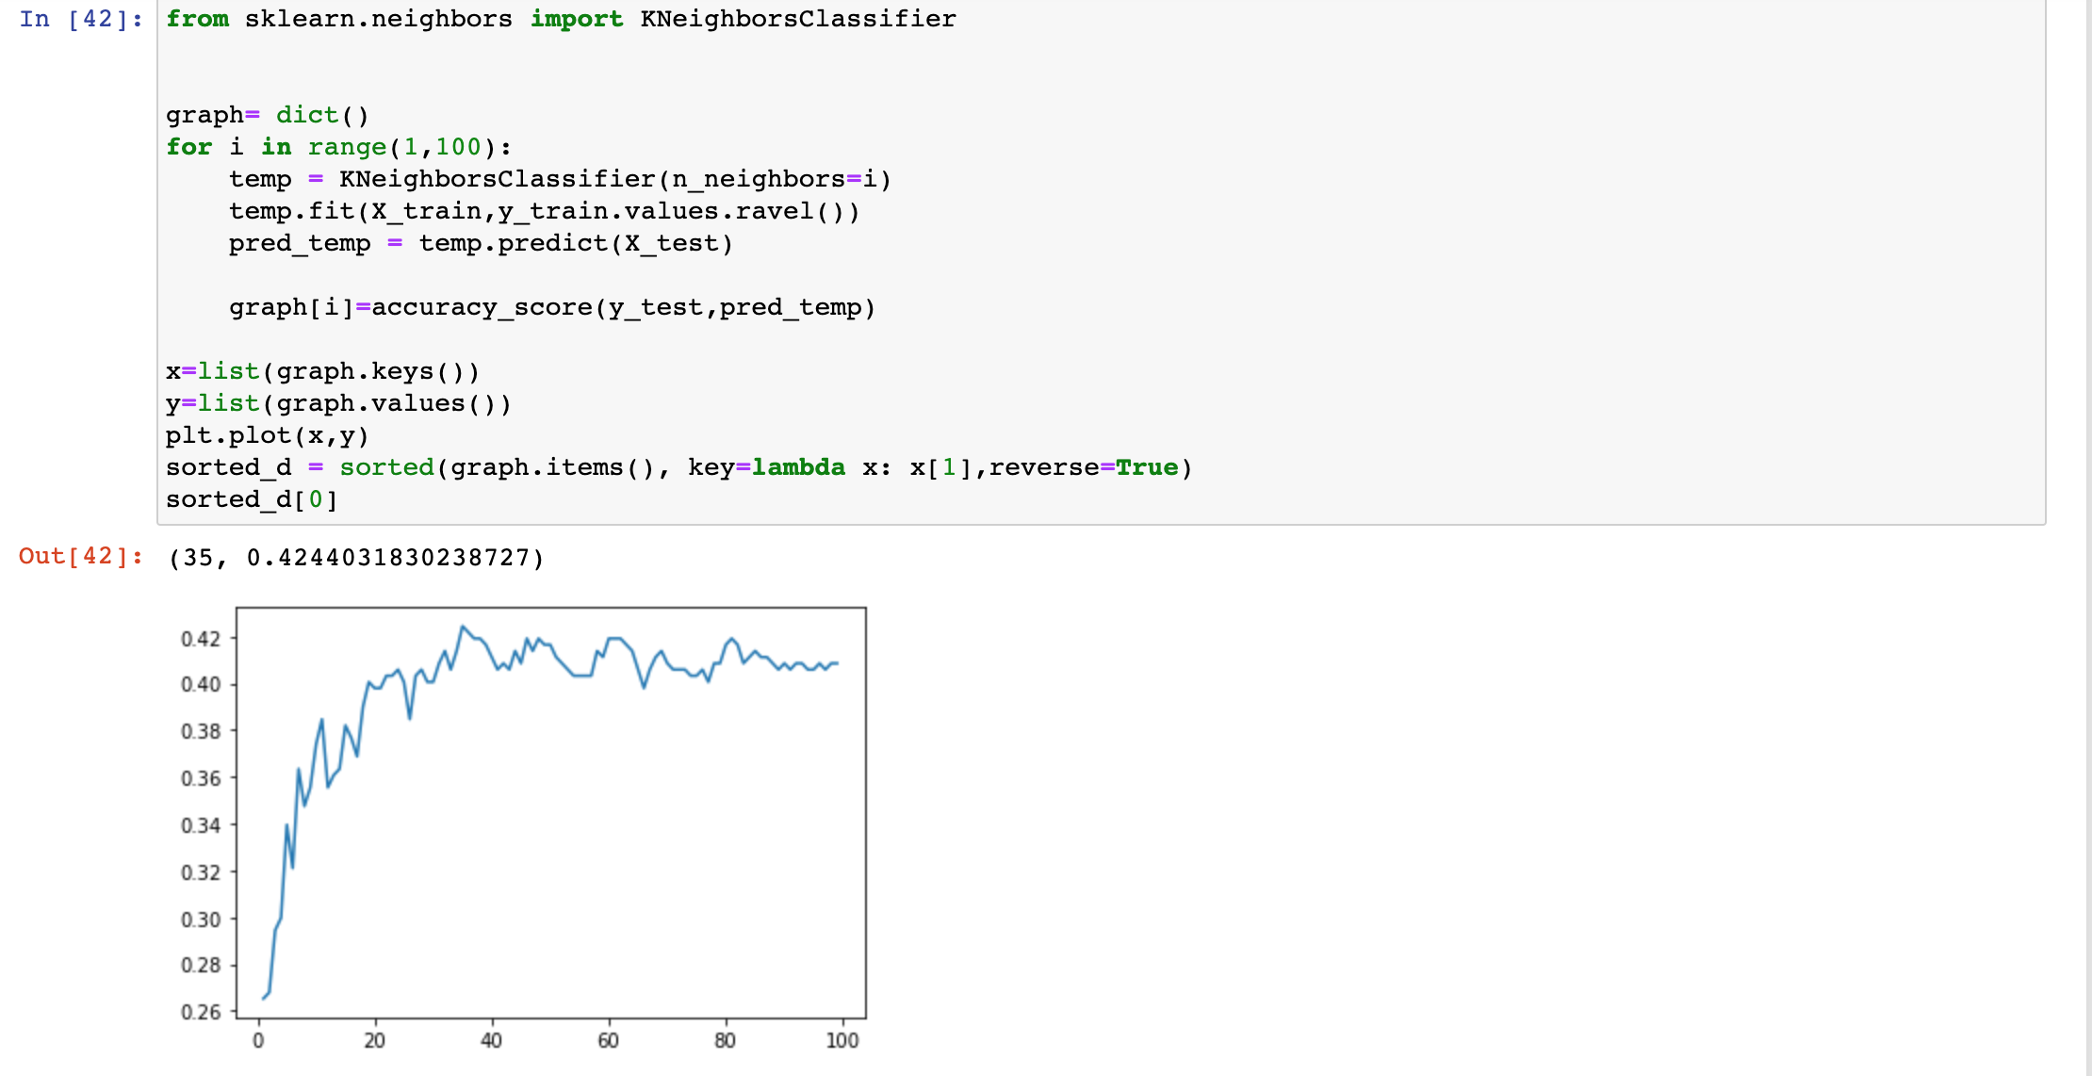
Machine Learning : KNN
I’ve tried to optimize it with finding the best number of neighbors and to see the impact on the accuracy.
It seems it’s not this path we had to follow to obtain good predictions.

Slide 24
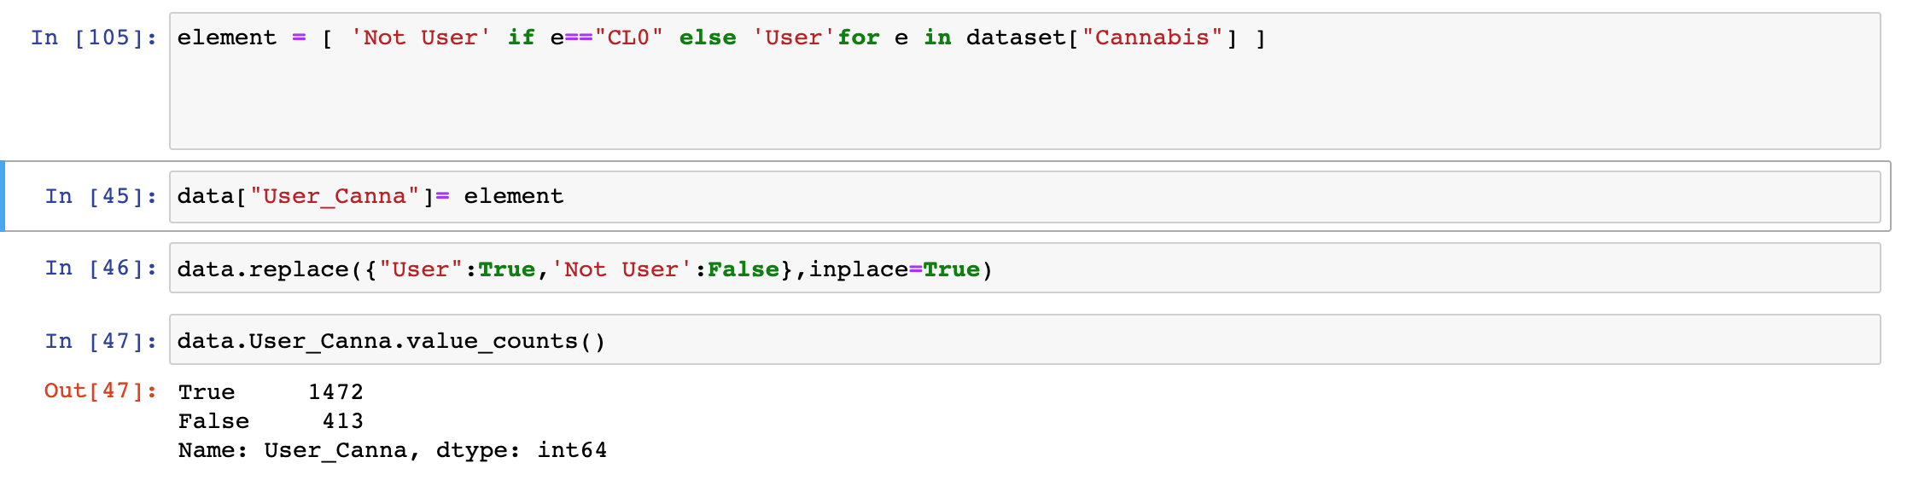
Machine Learning
So it leads me to create a new target : User_Canna. If a person has ever taken this drug one time, he will be categorized as an User. If not he’ll be a Not User.

Slide 25
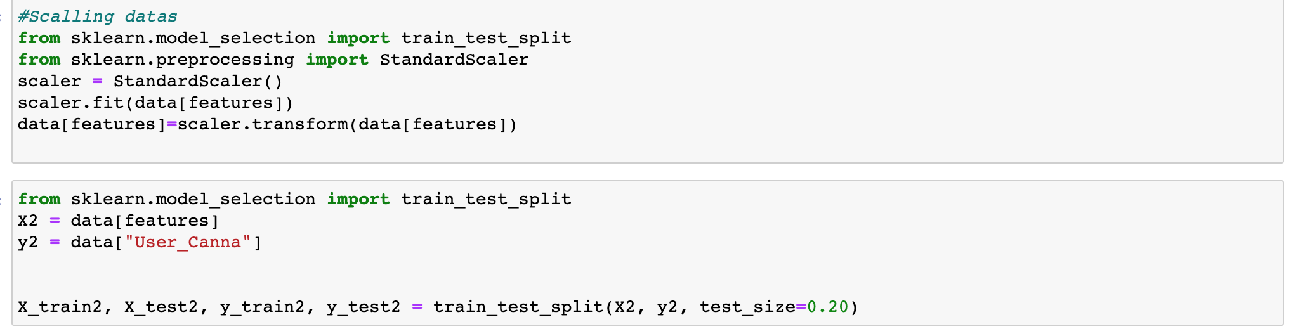
Machine Learning
I decided to scale the features too and I split again my dataset with my new target and my scaled features :

Slide 26
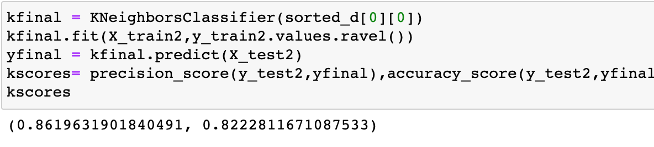
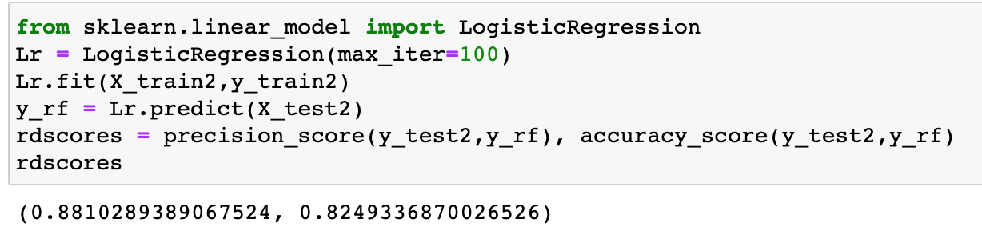
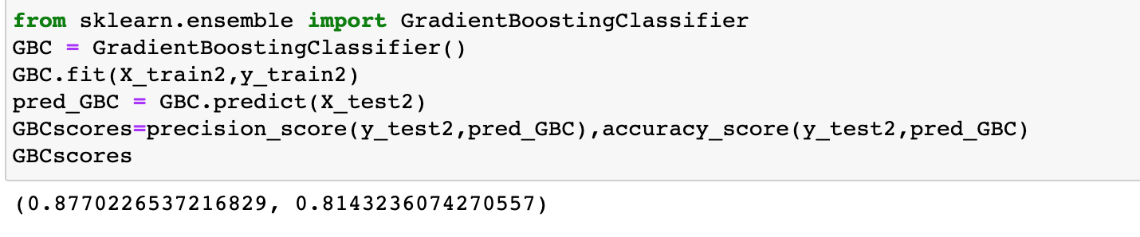
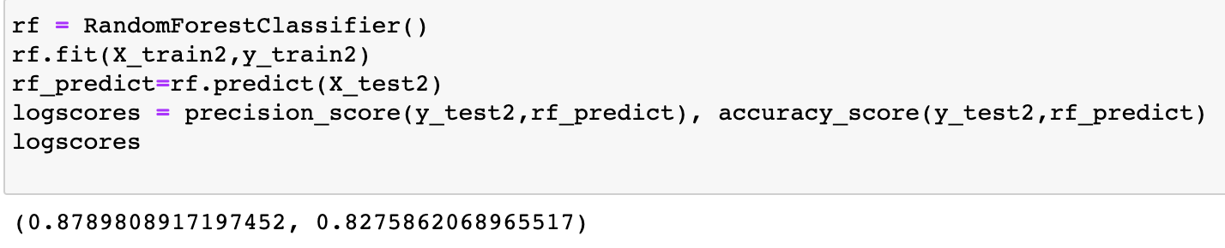
Machine Learning : The models
So here are the 4 model I chose: KNN , Logistic Regression, Gradient Boosting and Random Forest

Slide 27
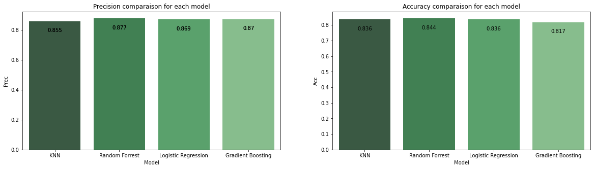
Machine Learning : Comparing the models
We can see the performances of the four previous models applied on our dataset.
Random Forrest seems to be the most efficient here.

Slide 28
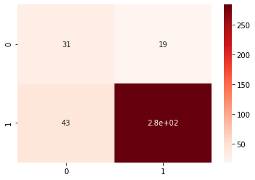
Machine Learning : Random Forest
Here is my confusion matrix for the Random Forest model
We can see that user are well predicted.

Slide 29
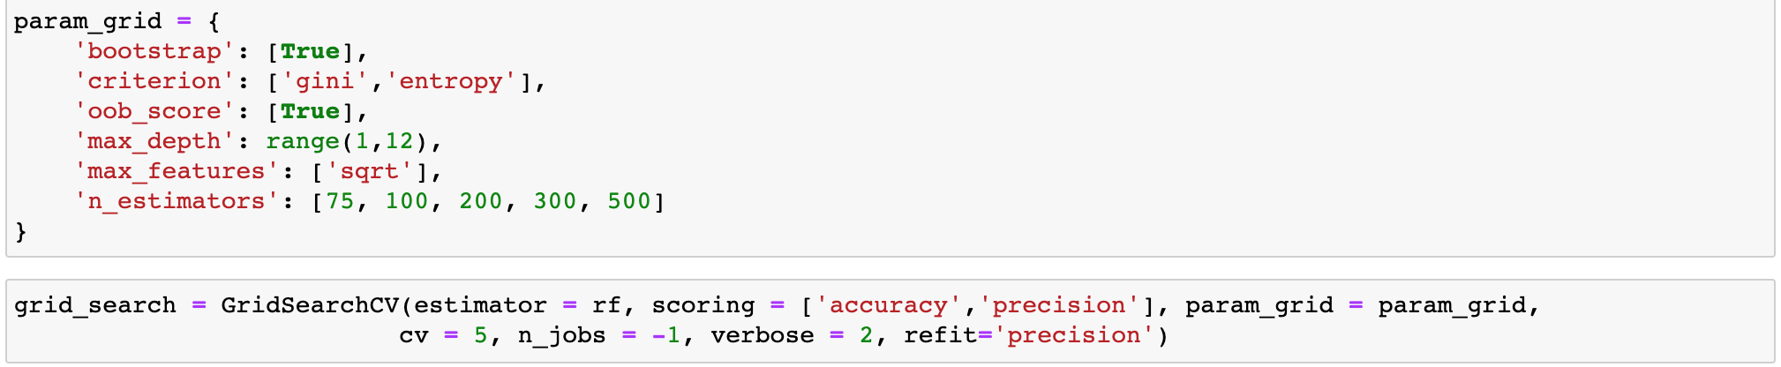
Machine Learning : Improving Random Forest
To improve my model I think of using a grid search in order to tune the hyperparameters to have a better accuracy and precision.

Slide 30
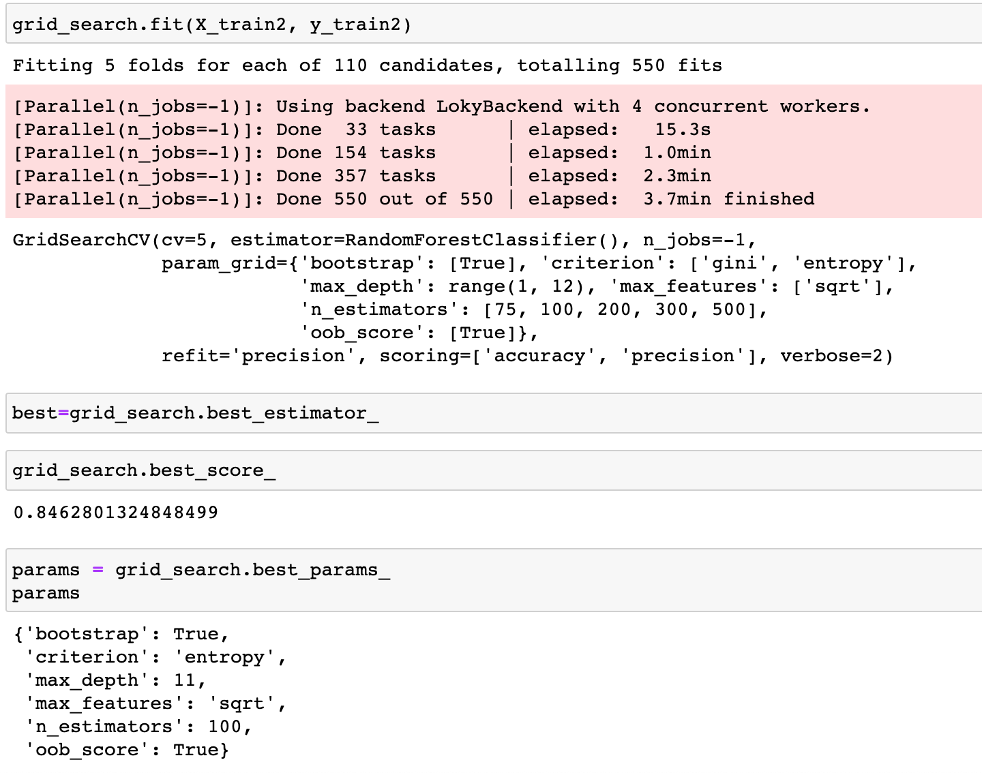
Machine Learning : Improving Random Forest
Here are the best hyperparameters for the Random Forest :
Best estimator:
RandomForestClassifier(criterion='entropy’, max_depth=11, max_features='sqrt’, oob_score=True)

Slide 31
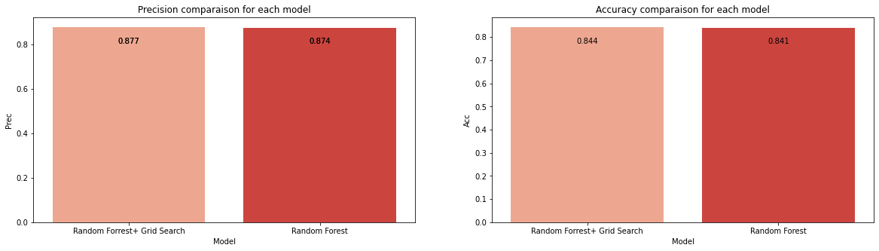
Machine Learning : Improving Random Forest
Comparaison between the two models of Random Forest. We can see there’s a little improvment after using a grid search :

Slide 32
The Flask API
To deploy my previous Machine Learning, I decided to work on Flask to build an API.
5 files are needed to allow it to work : the main python code (app.py), requirement.txt in which we have all the package dependencies needed to run app.py and 3 html files used to render templates.

Slide 33
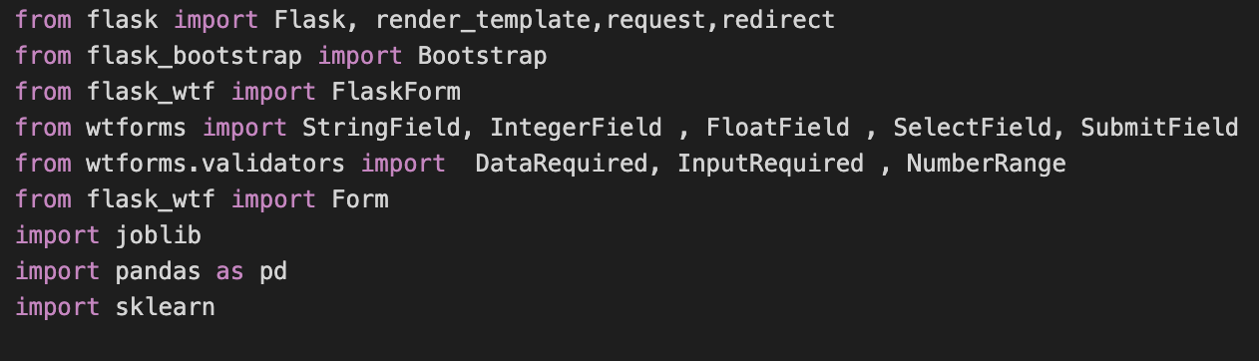
The Flask API
Here are to modules required to deploy our API.
Flask module will allow us to build our API, use the templates we defined and to set the route to access the different responses we want to give to the user.
Bootstrap gives us templates we can heritate and modify to custom our displays.
WTF forms bring the tools to fill forms in order to make our predictions with the given datas.
Joblib, Pandas and ScikitLearn are useful to get the prediction by using our previous ML model.

Slide 34
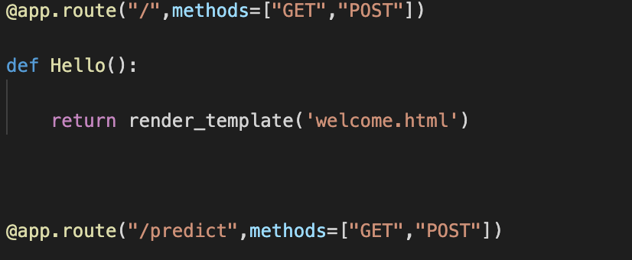
The Flask API
The 2 routes of our api are here :
The base route is the welcome page using our template welcome.
The /predict route is used, in the one hand, to fill the form by render the prediction template and asking user for input and, in the other hand, to display the results by render the result template on which we have our model response.

Slide 35
Conclusion
This dataset was very interresting to analyze. Predicting the drug consumptions given personnality scores could be a powerful tool to prevent drug addictions I think. Nevertheless our dataset is just representative for white American or English people, the population asked isn’t enough contrasted.
What could have been further done: I wish I had more time to deploy other ML models for remaining drugs and optimize the one I’ve created.

